Slide 1
W4111 – Introduction to Databases Section 002, Spring 2023 Lecture 7: ER, Relational, SQL Advanced Topics and Scenarios
© Donald F. Ferguson, 2023

Slide 2

Contents
2 | COMS W4111_002_2023_1: Lecture 7: ER, Relational, SQL, Scenarios, Applications © Donald F. Ferguson, 2023

Slide 3
Contents
REST, HATEOAS continued:
Review previously discussed concepts.
New concepts: Links, Location, … …
Window Functions
Advanced ER Modeling

Slide 4
Some Advanced and Miscellaneous SQL
4 | COMS W4111_002_2023_1: Lecture 7: ER, Relational, SQL, Scenarios, Applications © Donald F. Ferguson, 2023

Slide 5

Window Functions
5 | COMS W4111_002_2023_1: Lecture 7: ER, Relational, SQL, Scenarios, Applications © Donald F. Ferguson, 2023

Slide 6
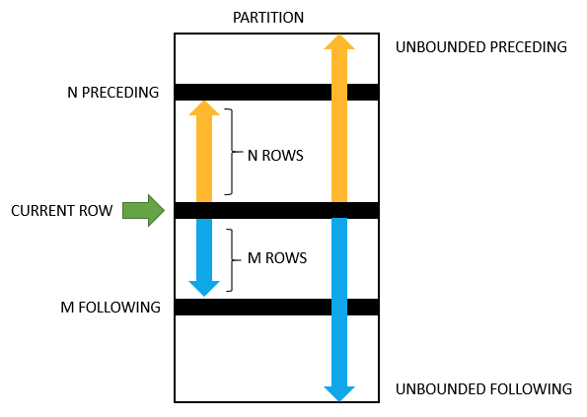
MySQL Window Functions
Syntax:
window_function_name(expression) OVER (
[partition_defintion]
[order_definition]
[frame_definition]
)
PARTITION BY <expression>[{,<expression>...}]
The partition_clause breaks up the rows into chunks or partitions. Two partitions are separated by a partition boundary.
The window function is performed within partitions and re-initialized when crossing the partition boundary.
ORDER BY <expression> [ASC|DESC], [{,<expression>...}]
The ORDER BY clause specifies how the rows are ordered within a partition.
frame_unit {<frame_start>|<frame_between>}
A frame is a subset of the current partition.
A frame is defined with respect to the current row, which allows a frame to move within a partition depending on the position of the current row within its partition.
Frames

Slide 7
Comments
Even by SQL standards and my explanations, this is baffling.
The only way to learn is practice.
Let’s switch to the notebook.

Slide 8
Interesting Things not Supported by MySQL
8 | COMS W4111_002_2023_1: Lecture 7: ER, Relational, SQL, Scenarios, Applications © Donald F. Ferguson, 2023

Slide 9
Assertions
An assertion is a predicate expressing a condition that we wish the database always to satisfy.
The following constraints, can be expressed using assertions:
For each tuple in the student relation, the value of the attribute tot_cred must equal the sum of credits of courses that the student has completed successfully.
An instructor cannot teach in two different classrooms in a semester in the same time slot
An assertion in SQL takes the form:
create assertion <assertion-name> check (<predicate>);

Slide 10
User-Defined Types
create type construct in SQL creates user-defined type
create type Dollars as numeric (12,2) final
Example:
create table department (dept_name varchar (20), building varchar (15), budget Dollars);

Slide 11
Domains
create domain construct in SQL-92 creates user-defined domain types
create domain person_name char(20) not null
Types and domains are similar. Domains can have constraints, such as not null, specified on them.
Example:
create domain degree_level varchar(10) constraint degree_level_test check (value in ('Bachelors', 'Masters', 'Doctorate'));

Slide 12
Some Advanced ER Modeling (And Implementing It)
12 | COMS W4111_002_2023_1: Lecture 7: ER, Relational, SQL, Scenarios, Applications © Donald F. Ferguson, 2023

Slide 13
Weak Entity Sets
Consider a section entity, which is uniquely identified by a course_id, semester, year, and sec_id.
Clearly, section entities are related to course entities. Suppose we create a relationship set sec_course between entity sets section and course.
Note that the information in sec_course is redundant, since section already has an attribute course_id, which identifies the course with which the section is related.
One option to deal with this redundancy is to get rid of the relationship sec_course; however, by doing so the relationship between section and course becomes implicit in an attribute, which is not desirable.

Slide 14
Weak Entity Sets (Cont.)
An alternative way to deal with this redundancy is to not store the attribute course_id in the section entity and to only store the remaining attributes section_id, year, and semester.
However, the entity set section then does not have enough attributes to identify a particular section entity uniquely
To deal with this problem, we treat the relationship sec_course as a special relationship that provides extra information, in this case, the course_id, required to identify section entities uniquely.
A weak entity set is one whose existence is dependent on another entity, called its identifying entity
Instead of associating a primary key with a weak entity, we use the identifying entity, along with extra attributes called discriminator to uniquely identify a weak entity.

Slide 15
Weak Entity Sets (Cont.)
An entity set that is not a weak entity set is termed a strong entity set.
Every weak entity must be associated with an identifying entity; that is, the weak entity set is said to be existence dependent on the identifying entity set.
The identifying entity set is said to own the weak entity set that it identifies.
The relationship associating the weak entity set with the identifying entity set is called the identifying relationship.
Note that the relational schema we eventually create from the entity set section does have the attribute course_id, for reasons that will become clear later, even though we have dropped the attribute course_id from the entity set section.

Slide 16
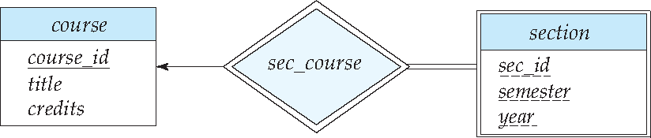
Expressing Weak Entity Sets
In E-R diagrams, a weak entity set is depicted via a double rectangle.
We underline the discriminator of a weak entity set with a dashed line.
The relationship set connecting the weak entity set to the identifying strong entity set is depicted by a double diamond.
Primary key for section – (course_id, sec_id, semester, year)

Slide 17
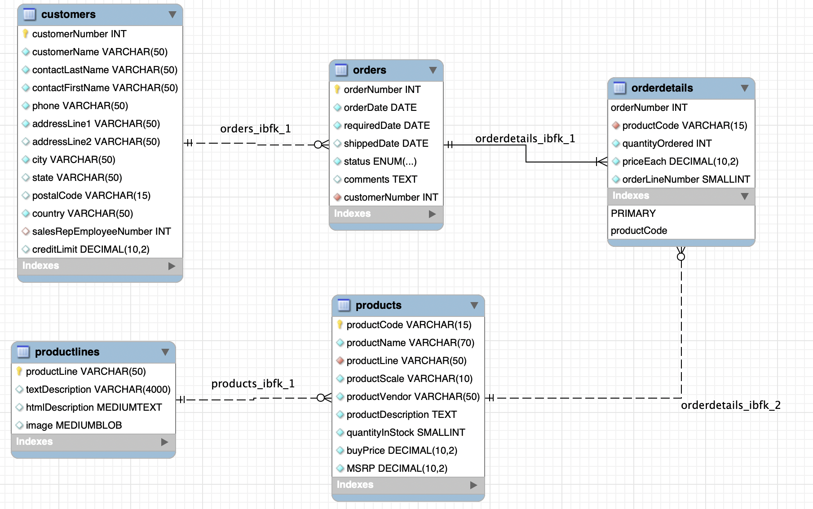
An Example – Classic Models
https://www.mysqltutorial.org/mysql-sample-database.aspx/
17 | Introduction to Databases (F21): Lecture 5: ER, Relational, SQL (IV)

Slide 18
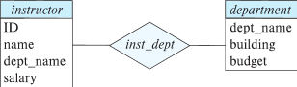
Redundant Attributes
Some of this only makes sense in this notation because it support relationships. Crow’s foot does not have this problem.
Suppose we have entity sets:
instructor, with attributes: ID, name, dept_name, salary
department, with attributes: dept_name, building, budget
We model the fact that each instructor has an associated department using a relationship set inst_dept
The attribute dept_name in instructor replicates information present in the relationship and is therefore redundant
and needs to be removed.
BUT: when converting back to tables, in some cases the attribute gets reintroduced, as we will see later.

Slide 19
Design Alternatives
In designing a database schema, we must ensure that we avoid two major pitfalls:
Redundancy: a bad design may result in repeat information.
Redundant representation of information may lead to data inconsistency among the various copies of information
Incompleteness: a bad design may make certain aspects of the enterprise difficult or impossible to model.
Avoiding bad designs is not enough. There may be a large number of good designs from which we must choose.
Emphasis Added
Notes:
19

Slide 20
Complex Attributes
Attribute types:
Simple and composite attributes.
Single-valued and multivalued attributes
Example: multivalued attribute: phone_numbers
Derived attributes
Can be computed from other attributes
Example: age, given date_of_birth
Domain – the set of permitted values for each attribute
DFF: Jump into notebook and show examples from IMDB.

Slide 21
Composite Attributes
Composite attributes allow us to divided attributes into subparts (other attributes).

Slide 22
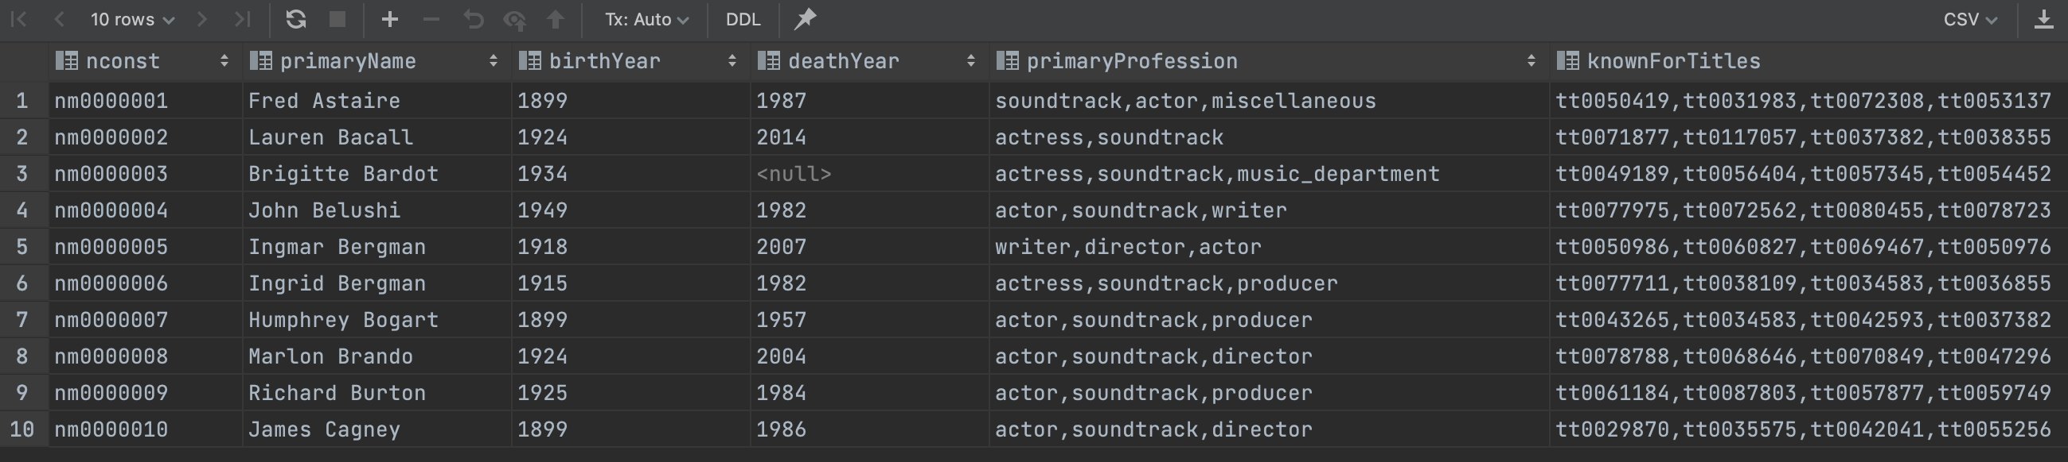
Example from IMDB
Consider name_basics
There
Is one composite attribute, primaryName.
Are two multivalued attributes: primaryProfession, knownForTitles
knownForTitles is also tricky, which we will see.
Names are also a little tricky
Switch to notebook

Slide 23
Relationship Sets (Cont.)
An attribute can also be associated with a relationship set.
For instance, the advisor relationship set between entity sets instructor and student may have the attribute date which tracks when the student started being associated with the advisor

Slide 24
Relationship Sets with Attributes

Slide 25
Roles
Entity sets of a relationship need not be distinct
Each occurrence of an entity set plays a “role” in the relationship
The labels “course_id” and “prereq_id” are called roles.

Slide 26
Degree of a Relationship Set
Binary relationship
involve two entity sets (or degree two).
most relationship sets in a database system are binary.
Relationships between more than two entity sets are rare. Most relationships are binary. (More on this later.)
Example: students work on research projects under the guidance of an instructor.
relationship proj_guide is a ternary relationship between instructor, student, and project

Slide 27
Non-binary Relationship Sets
Most relationship sets are binary
There are occasions when it is more convenient to represent relationships as non-binary.
E-R Diagram with a Ternary Relationship

Slide 28
Mapping Cardinality Constraints
Express the number of entities to which another entity can be associated via a relationship set.
Most useful in describing binary relationship sets.
For a binary relationship set the mapping cardinality must be one of the following types:
One to one
One to many
Many to one
Many to many

Slide 29
Aggregation
Consider the ternary relationship proj_guide, which we saw earlier
Suppose we want to record evaluations of a student by a guide on a project

Slide 30
Aggregation (Cont.)
Relationship sets eval_for and proj_guide represent overlapping information
Every eval_for relationship corresponds to a proj_guide relationship
However, some proj_guide relationships may not correspond to any eval_for relationships
So we can’t discard the proj_guide relationship
Eliminate this redundancy via aggregation
Treat relationship as an abstract entity
Allows relationships between relationships
Abstraction of relationship into new entity

Slide 31
Aggregation (Cont.)
Eliminate this redundancy via aggregation without introducing redundancy, the following diagram represents:
A student is guided by a particular instructor on a particular project
A student, instructor, project combination may have an associated evaluation
Notes:
31

Slide 32
Reduction to Relational Schemas
To represent aggregation, create a schema containing
Primary key of the aggregated relationship,
The primary key of the associated entity set
Any descriptive attributes
In our example:
The schema eval_for is:
eval_for (s_ID, project_id, i_ID, evaluation_id)
The schema proj_guide is redundant.

Slide 33
Watch the Professor Do Stuff
33 | COMS W4111_002_2023_1: Lecture 7: ER, Relational, SQL, Scenarios, Applications © Donald F. Ferguson, 2023

Slide 34
REST (Again)
34 | COMS W4111_002_2023_1: Lecture 7: ER, Relational, SQL, Scenarios, Applications © Donald F. Ferguson, 2023

Slide 35
REST (https://restfulapi.net/)
What is REST
REST is acronym for REpresentational State Transfer. It is architectural style for distributed hypermedia systems and was first presented by Roy Fielding in 2000 in his famous dissertation.
Like any other architectural style, REST also does have it’s own 6 guiding constraints which must be satisfied if an interface needs to be referred as RESTful. These principles are listed below.
Guiding Principles of REST
Client–server – By separating the user interface concerns from the data storage concerns, we improve the portability of the user interface across multiple platforms and improve scalability by simplifying the server components.
Stateless – Each request from client to server must contain all of the information necessary to understand the request, and cannot take advantage of any stored context on the server. Session state is therefore kept entirely on the client.
Cacheable – Cache constraints require that the data within a response to a request be implicitly or explicitly labeled as cacheable or non-cacheable. If a response is cacheable, then a client cache is given the right to reuse that response data for later, equivalent requests.
Uniform interface – By applying the software engineering principle of generality to the component interface, the overall system architecture is simplified and the visibility of interactions is improved. In order to obtain a uniform interface, multiple architectural constraints are needed to guide the behavior of components. REST is defined by four interface constraints: identification of resources; manipulation of resources through representations; self-descriptive messages; and, hypermedia as the engine of application state.
Layered system – The layered system style allows an architecture to be composed of hierarchical layers by constraining component behavior such that each component cannot “see” beyond the immediate layer with which they are interacting.
Code on demand (optional) – REST allows client functionality to be extended by downloading and executing code in the form of applets or scripts. This simplifies clients by reducing the number of features required to be pre-implemented.

Slide 36
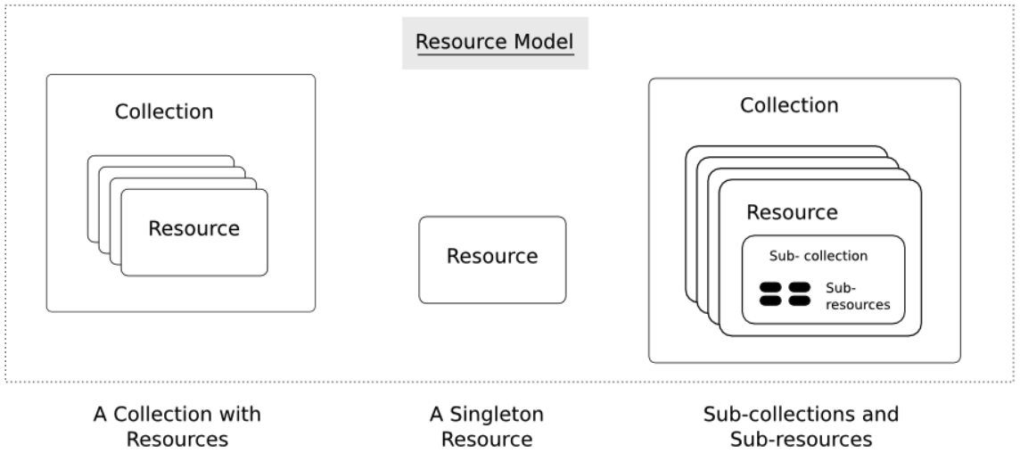
Resources
Resources are an abstraction. The application maps to create things and actions.
“A resource-oriented API is generally modeled as a resource hierarchy, where each node is either a simple resource or a collection resource. For convenience, they are often called a resource and a collection, respectively.
A collection contains a list of resources of the same type. For example, a user has a collection of contacts.
A resource has some state and zero or more sub-resources. Each sub-resource can be either a simple resource or a collection resource.
For example, Gmail API has a collection of users, each user has a collection of messages, a collection of threads, a collection of labels, a profile resource, and several setting resources.
While there is some conceptual alignment between storage systems and REST APIs, a service with a resource-oriented API is not necessarily a database, and has enormous flexibility in how it interprets resources and methods. For example, creating a calendar event (resource) may create additional events for attendees, send email invitations to attendees, reserve conference rooms, and update video conference schedules. (Emphasis added) (https://cloud.google.com/apis/design/resources#resources)
https://restful-api-design.readthedocs.io/en/latest/resources.html

Slide 37
REST – Resource Oriented
When writing applications, we are used to writing functions or methods:
openAccount(last_name, first_name, tax_payer_id)
account.deposit(deposit_amount)
account.close()
We can create and implement whatever functions we need.
REST only allows four methods:
POST: Create a resource
GET: Retrieve a resource
PUT: Update a resource
DELETE: Delete a resource
That’s it. That’s all you get.
A REST client needs no prior knowledge about how to interact with any particular application or server beyond a generic understanding of hypermedia.
“The key characteristic of a resource-oriented API is that it emphasizes resources (data model) over the methods performed on the resources (functionality). A typical resource-oriented API exposes a large number of resources with a small number of methods.” (https://cloud.google.com/apis/design/resources)

Slide 38
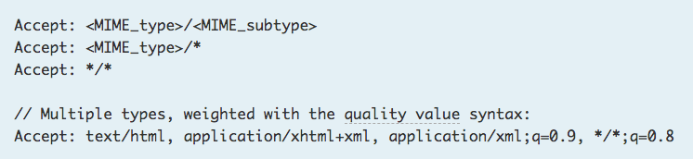
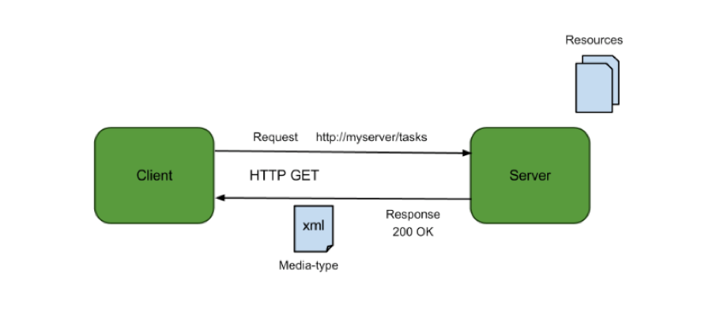
Resources, URLs, Content Types
Relative URL identifies “resource” on the server.
Server implementation maps abstract resource to tangible “thing,” file, DB row, … and any application logic.
Accept type in headers.
Client may be
Browser
Mobile device
Other REST Service
… …
Web media (content) type, e.g.
text/html
application/json

Slide 39
REST Principles
What about all of those principles?
Client/Server
Stateless
Cacheable
Uniform Interface
Layered System
Code on demand
Some of these principles
Are simple and obvious.
Are subtle and have major implications.
Stateless can be baffling, but we will cover later.
We will go into the principles in later lectures, ... but first linked resources ... ...

Slide 40
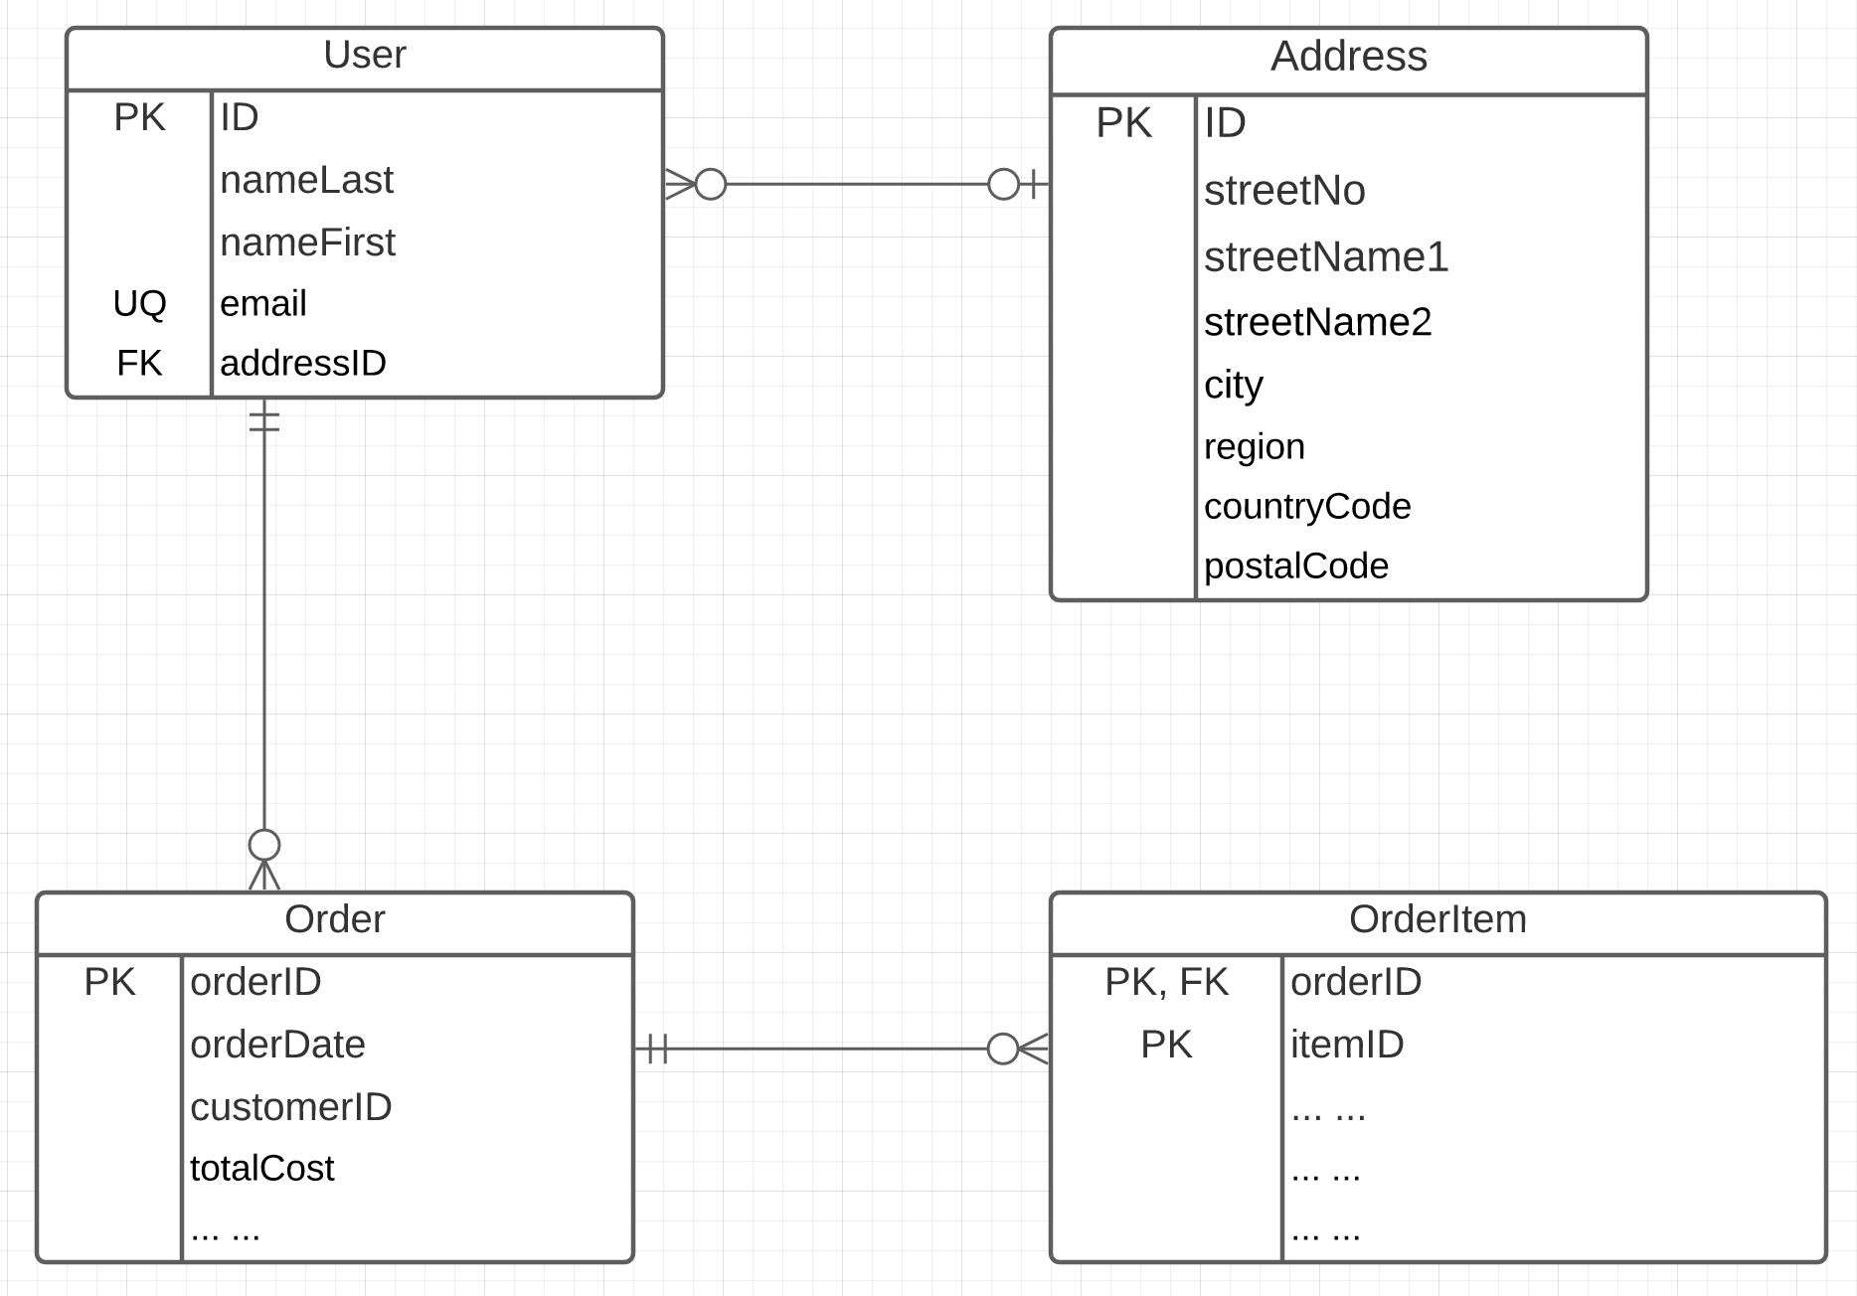
Linked Data
Consider two microservices:
UserService handles two resources:
User
Address
OrderService handles two resources:
Order
OrderItem
Associations/Link/Relationships can be surprisingly complicated. There are many considerations. (See https://www.uml-diagrams.org/association.html)
In this example, we have
Association (User-Address, User-Order)
Composition (Order-OrderItem)

Slide 41
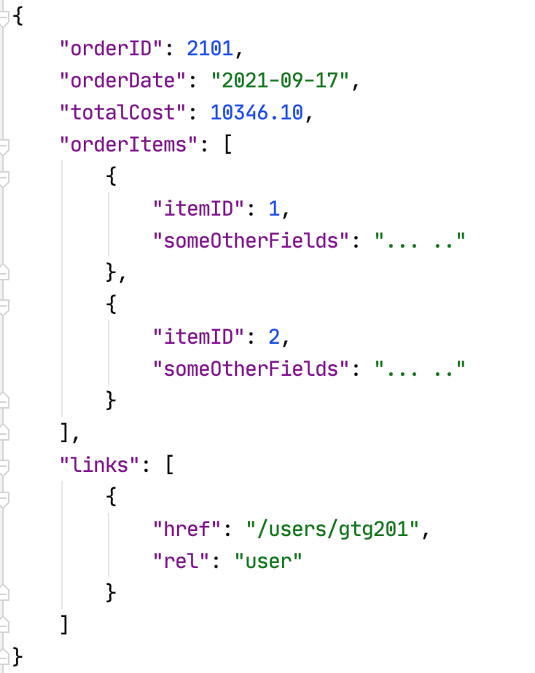
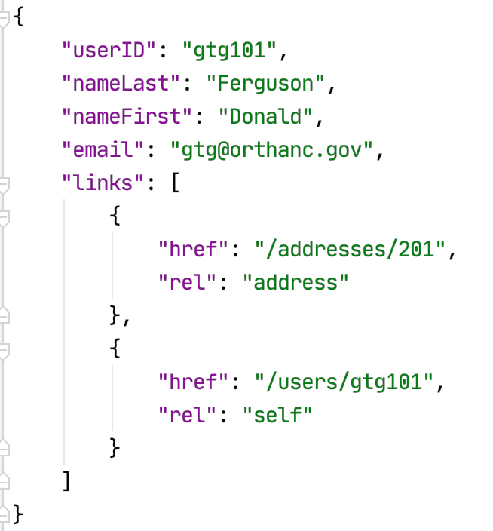
Resource Paths
The simple object model might/could/would/should have the following:
/users
/users/<userID>
/users/<userID>/address
/users/<userID>/orders
/addresses
/addresses/<addressID>/users
/orders/<orderID>
/orders/<orderID>/orderitems
/orders<orderID>/orderitems/<itemID>
... ...
How do you “point backwards” in a “foreign key relationship,” e.g. Address → User
“href” : “/users?addressID=201”
This means you store the addressID in the DB but return a link om REST.
Composition
Association

Slide 42
Backup
42 | COMS W4111_002_2023_1: Lecture 7: ER, Relational, SQL, Scenarios, Applications © Donald F. Ferguson, 2023

Slide 43
Specialization
Top-down design process; we designate sub-groupings within an entity set that are distinctive from other entities in the set.
These sub-groupings become lower-level entity sets that have attributes or participate in relationships that do not apply to the higher-level entity set.
Depicted by a triangle component labeled ISA (e.g., instructor “is a” person).
Attribute inheritance – a lower-level entity set inherits all the attributes and relationship participation of the higher-level entity set to which it is linked.

Slide 44
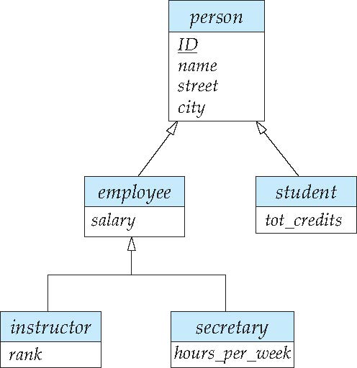
Specialization Example
Overlapping – employee and student
Disjoint – instructor and secretary
Total and partial

Slide 45
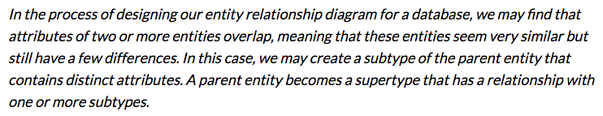
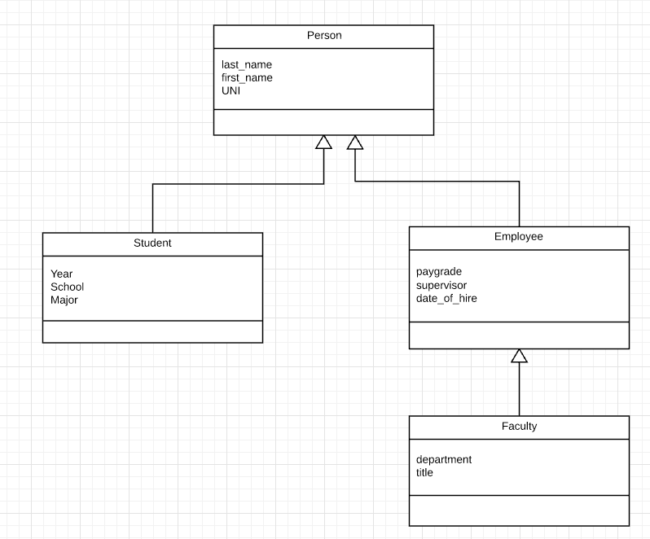
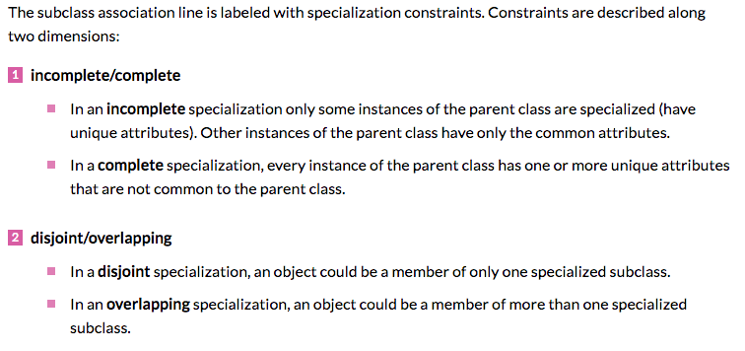
Inheritance/Specialization
Are all employees faculty?
Can students also be employees?
http://www.vertabelo.com/blog/technical-articles/inheritance-in-a-relational-database

Slide 46
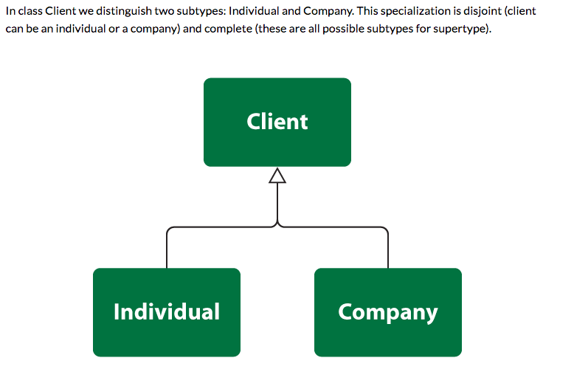
Specialization

Slide 47
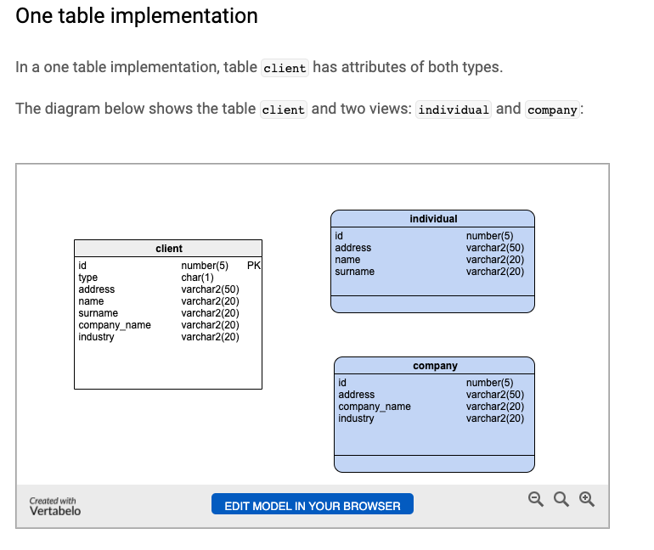
One Table
Views
Tables

Slide 48
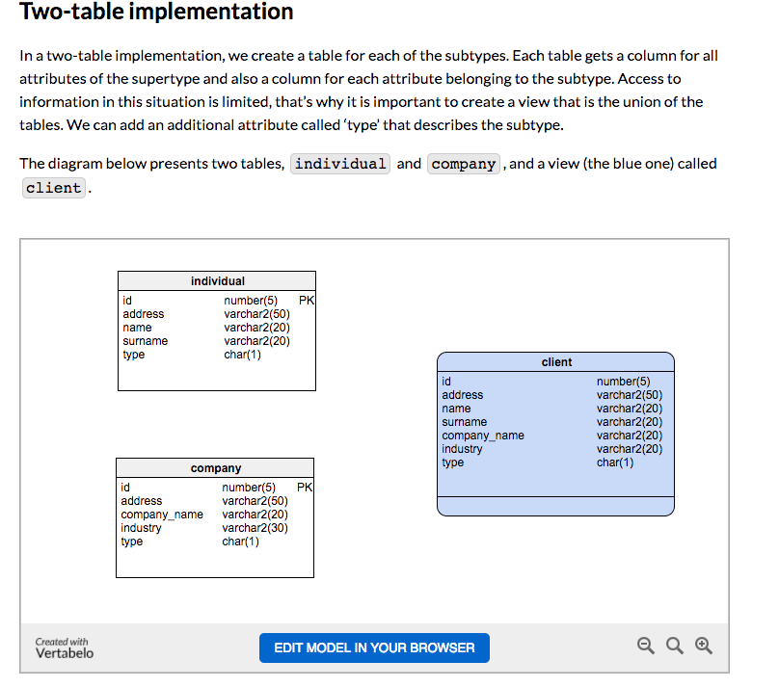
Two Table
View
Tables

Slide 49
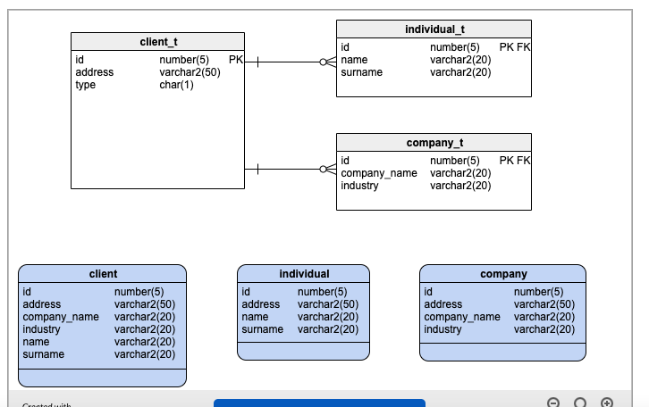
Three Table

Slide 50
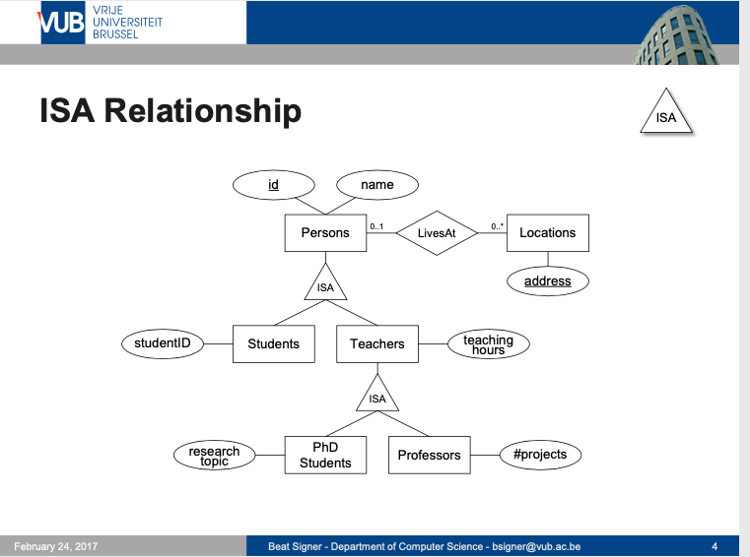
Modeling
50 | W4111_02_F20: Introduction to Databases – Lecture 7

Slide 51
ER vs. UML Class Diagrams
ER Diagram Notation
Equivalent in UML
I use this approach in Crow’s Foot Notation but that is not standard.
* Generalization can use merged or separate arrows independent
of disjoint/overlapping

